Slide 1
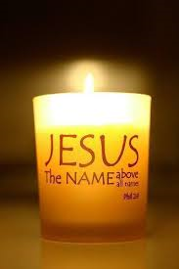
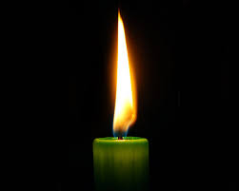
在祢殿中
IN YOUR TEMPLE

Slide 2
我願在祢殿中 俯伏敬拜稱謝 數算祢恩典 思念祢的慈愛 述説祢的榮耀 敬拜到永遠
How I love Your temple,Falling down in worship,
Thankful for Your grace,
Cherishing Your goodness, Telling of Your greatness,
Bowed in endless praise.

Slide 3
我願在祢殿中 俯伏敬拜稱謝 數算祢恩典 思念祢的慈愛 述説祢的榮耀 敬拜到永遠
How I love Your temple,Falling down in worship,
Thankful for Your grace,
Cherishing Your goodness, Telling of Your greatness,
Bowed in endless praise.

Slide 4
耶穌 耶穌 聖潔的羔羊 耶穌 耶穌 一生敬拜祢
Jesus, Lamb of God,
Holy Lamb of God!
Jesus, I shall praise,
Praise You all my days!

Slide 5
在祢殿中一日 勝別處住千日 心何等甘甜 瞻仰祢的榮面 聆聽祢的聲音 浸入永恆間
One day in Your temple, Not a thousand elsewhere,
Is my heart's desire,
Gazing at Your beauty, Listening as You call me,
Steeped in endless time.

Slide 6
我願在祢殿中 俯伏敬拜稱謝 數算祢恩典 思念祢的慈愛 述説祢的榮耀 敬拜到永遠
How I love Your temple,Falling down in worship,
Thankful for Your grace,
Cherishing Your goodness, Telling of Your greatness,
Bowed in endless praise.

Slide 7
耶穌 耶穌 聖潔的羔羊 耶穌 耶穌 一生敬拜祢 一生敬拜祢 一生敬拜祢
Jesus, Jesus, Holy Lamb of God!
Jesus, Jesus, Praise You all my days!
Praise You all my days!
Praise You all my days!

